Slide 1
Covid-19 Fact Checking
🦠🛂
Duc Nguyen Nigel Yong

Slide 2
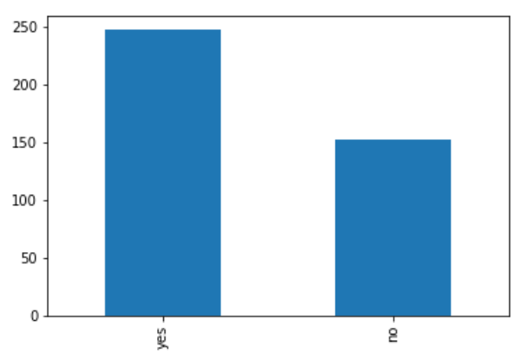
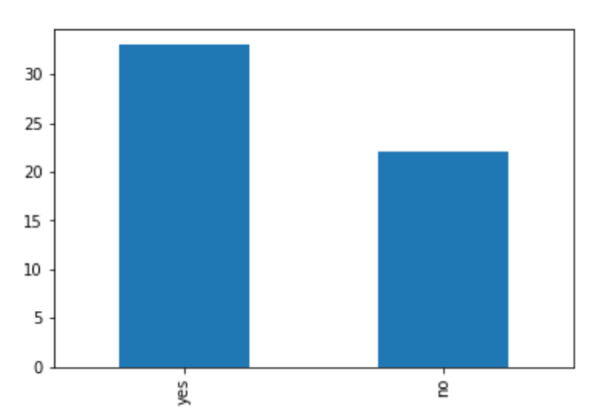
Initial Dataset Analysis
Not all of the text are words
Hashtags, emojis, special characters, might impact performance
Imbalanced data, might have better performance for yes label.
Relatively small dataset
Training
Testing

Slide 3
Vocabulary Analysis
NB-BOW-OV:
Includes any words
3437 words
Best accuracy, precision, recall and f1
NB-BOW-FV:
Includes words appearing more than twice only
1027 words
Small reduction in metrics performance.
Did not do as well as expected
Lower recall and F1 measure
Words occurring once only in this task might be important
Especially not a lot of data

Slide 4
Difference in performance in LSTM (5 runs)
Accuracy | 0.7222 | 0.5741 | 0.7593 | 0.7593 | 0.7593
per-class precision | 0.7143 0.75 | 0.7273 0.4688 | 0.75 0.7857 | 0.7381 0.8333 | 0.75 0.7857
per-class recall | 0.9091 0.4286 | 0.4848 0.7143 | 0.9091 0.5238 | 0.9394 0.4762 | 0.9091 0.5238
per-class F1-measure | 0.8 0.5455 | 0.5818 0.566 | 0.8219 0.6286 | 0.8267 0.60617 | 0.8219 0.6286
Variable performance, depending on initialization, rarely bad performance (1/5)
Mode accuracy of 0.7593
In the best case
performs well for yes labels in recall and f1 measure
Performs well for no labels in precision

Slide 5
Models Performance Comparison
 | LSTM | NB-BOW OV | NB-BOW FV
Accuracy | 0.7593 | 0.7455 | 0.6727
per-class precision | 0.75 0.7857 | 0.7317 0.7857 | 0.6667 0.7
per-class recall | 0.9091 0.5238 | 0.9091 0.5 | 0.9091 0.3182
per-class F1-measure | 0.8219 0.6286 | 0.8108 0.6111 | 0.7692 0.4375
LSTM performs the best in all categories among all of them
NB-BOW OV 2nd best with equal performance in precision and recall for some classes
NB-BOW sometimes perform better than LSTM

Slide 6
Responsibilities and contributions
Nigel
NB-BOW FV/ OV first working draft
Dataset Analysis
Peer code review and testing
Duc
NB-BOW FV/ OV final working code
Metrics generation
Peer code review and testing

Slide 7
Thank you! 😁

